Slide 1
COMP 1800
Week 2 - Friday

Slide 2
Last time
What did we talk about last time?
Selection statements (if)
random library
Monte Carlo approximation

Slide 3
Questions?

Slide 4
Else

Slide 5
Either/Or
Sometimes you have to make a decision
If a condition is true, you go one way, if not, you go the other
For example:
If I win the lottery,
I'll buy a Lamborghini
Otherwise,
I'll cry myself to sleep

Slide 6
Exclusivity
Note the nature of this kind of condition
Both outcomes cannot happen
Either you buy a Lamborghini or cry yourself to sleep, never both
For these situations, we use the else construct

Slide 7
Anatomy of an if-else
if condition :
A statements
else :
B statements
Two different outcomes

Slide 8
else example
if balance < 0:
print('You are in debt!')
else:
print('You have $' + str(balance))

Slide 9
if and elif
What if you have a list of mutually exclusive conditions?
You can tie all the possibilities together starting with if, then for each additional condition, you use elif to check it, and then you can optionally end with an else if none of the other conditions were met
if index == 1:
print('First')
elif index == 2:
print('Second')
elif index == 3:
print('Third')
else:
print(str(index) + "th")

Slide 10
Back to Monte Carlo

Slide 11
Recall the random library
The random library lets us produce random numbers
It has two functions that will be useful to us:
randint(a, b): Returns a random integer n where a ≤ n ≤ b
random(): Returns a random floating-point value from [0, 1)
To use them, import random and then call the functions qualified by random followed by a period:
import random
dice = random.randint(1, 6)
percentage = random.random()

Slide 12
Monte Carlo approximation of π
We can do something called a
Monte Carlo approximation of π
We "throw" darts at a 1 x 1 square
in the upper right corner of a
circle with radius 1
We count the ones that fall inside the circle and divide by the total darts thrown
That fraction is an estimation of the area of one fourth of the circle
By multiplying by 4, we approximate π
y
x

Slide 13
Monte Carlo approximation function
Here is a function that performs the Monte Carlo approximation:
import random
def monteCarlo(darts):
hits = 0
for i in range(darts):
x = random.random()
y = random.random()
if x*x + y*y <= 1.0: # see if dart is in circle
hits += 1
return 4.0 * hits / darts

Slide 14
Drawing the Monte Carlo approximation
We can use the turtle package to draw the darts that we "throw" when doing the Monte Carlo approximation
We need to do two things:
Scale the screen so that it's the right size for the dots we're drawing
We want the screen to go from (0, 0) up to (1, 1)
Draw a blue dot when the dart is in the circle and a red dot when it's not
(o, 1)
(o, 0)
(1, 0)

Slide 15
Scaling the screen
How far do the coordinates stretch on the normal turtle screen?
Who knows?!
However, we can get the screen with the following command (as long as we already imported turtle)
Then, we can set the minimum x, minimum y, maximum x, and maximum y with the setworldcoordinates() method
screen = turtle.Screen()
screen.setworldcoordinates(0, 0, 1, 1) #(0,0) to (1,1)

Slide 16
Drawing dots
To draw a dot at a location, use the goto() method followed by the dot() method
Assuming you have a turtle object named yertle:
Before drawing a dot, you can set the color to draw by calling the color() method with a color:
Before drawing dots, put the turtle's tail up with the up() method so that it doesn't draw lines everywhere
yertle.goto(x, y)
yertle.dot()
yertle.color('blue')

Slide 17
Work Time for Assignments 1 and 2

Slide 18
Upcoming

Slide 19
Next time…
Strings
Concatenation
Repetition
Indexing
Slicing
Searching

Slide 20
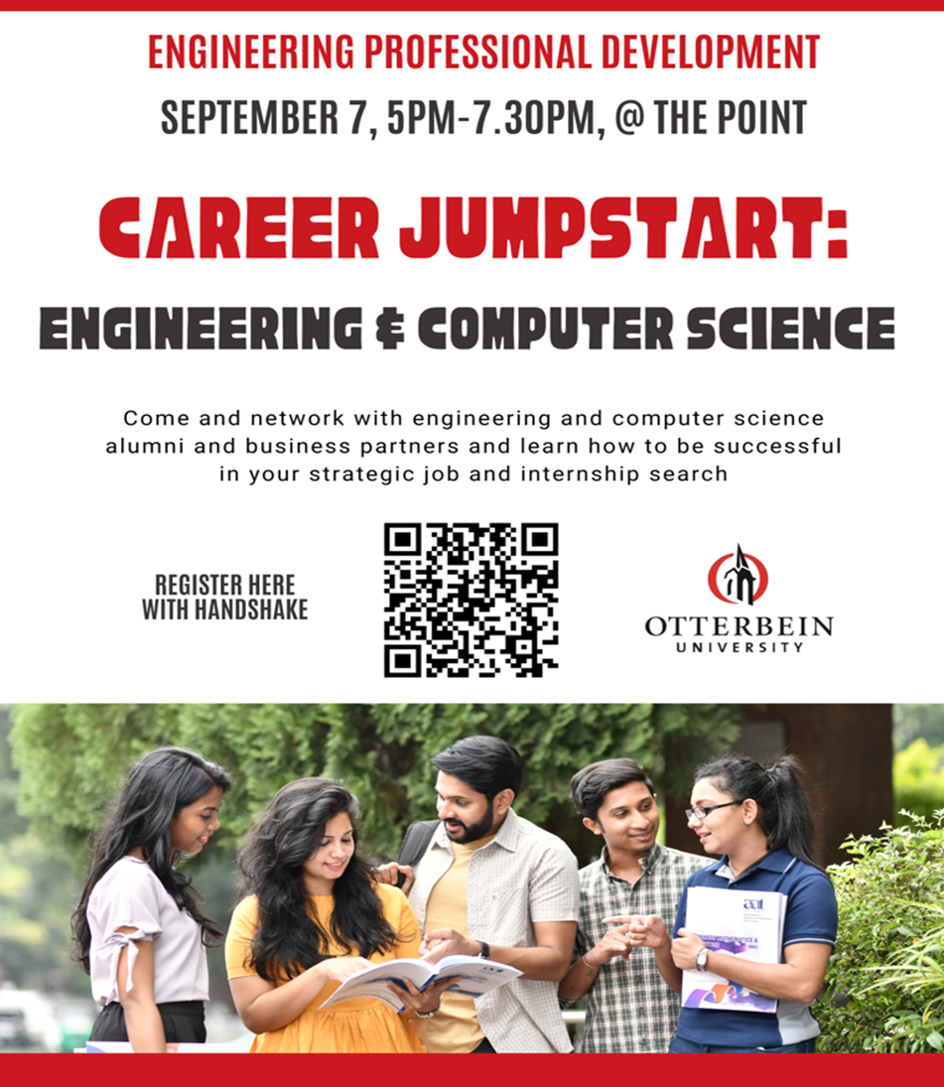
20 employers in the fields of Engineering and Computer Science
20 alumni members attending
Free professional LinkedIn headshots
Plenty of food and great conversations
Build new connections on LinkedIn
Door prizes
Network with people in your field
Learn about possible internships
Gain new insights about your major
Required event for all sophomores

Slide 21
Reminders
Read Section 3.2 of the textbook
Finish Assignment 1
Due tonight by midnight!
Work on Assignment 2
Due next Friday by midnight

